Slide 1





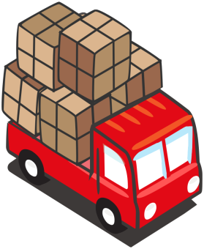

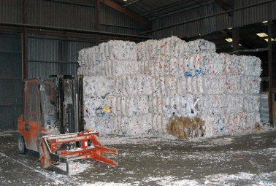






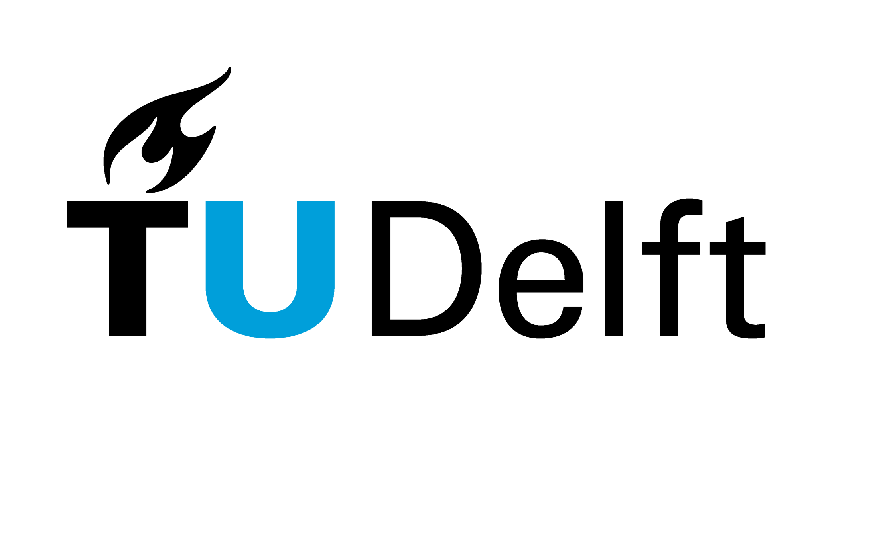

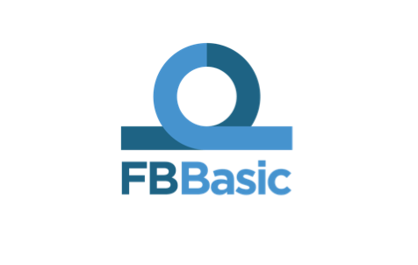
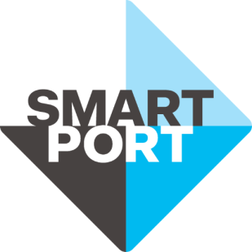

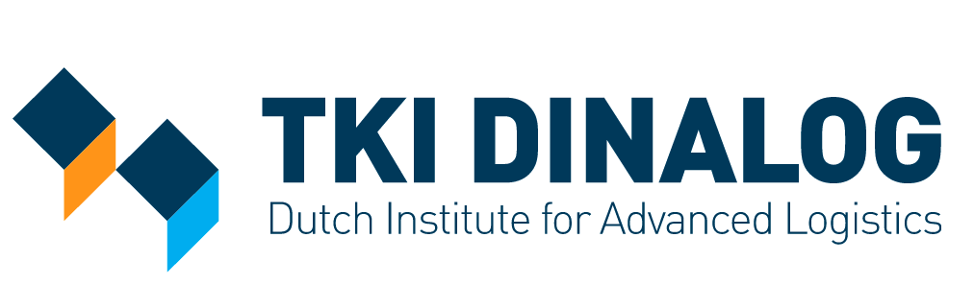



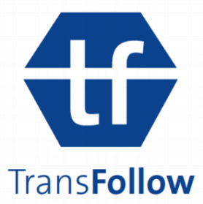






Blockchain and Logistic Innovation:
Theories, Challenges, and Applications
Zhijie Ren, Zekeriya Erkin, and Johan Pouwelse
Blockchain
A cryptographic technique behind Bitcoin which provides security, consensus, and trust in a distributed system.
Hash of the previous block
Data
1, Distributed system in an unsafe environment.
2, Append-only and tamper-proof date structure.
3, Consensus protocol to decide the new block.
TrustChain
Features:
Blockchain based on 10 years of Tribler ledger research and experience.
Each node creates their own genesis block + chain.
Goes beyond cybercurrency, general support for transactions on TrustChain.
Advantages:
Scalable throughput.
Less overhead in communication and storage.
A reputation mechanism, NetFlow, is used to resist Sybil attack.
A TrustChain System
Logistic Innovation
Blockchain is used in 3 use-cases in the Dutch logistic industry and provides new possibilities.
Seller
Carrier
Buyer
Owner
Factory
Raw Material
Goods
Goods
Money
Bank
Smart
Contract
Smart
Contract
Smart
Contract
Goods
Proofs
Blockchain
Warehouse
Product
Waste
Blockchain
Case 2: Using blockchain to provide reliable proofs for the banks to finance on the deposit.
Case 1: Using blockchain to enable an instant payment to the carrier with smart contract.
Case 3: Using blockchain to trace the material and enable the sharing economy.
Zhijie Ren
Postdoc Researcher
Cyber Security Group
Department of Intelligent Systems
Delft University of Technology
E-mail: z.ren@tudelft.nl
Telephone: +31(0)15 2783227

